Slide 1
Kyle Hartung, EdD Director, Pathways to Prosperity November 10, 2016
Using Design thinking to solve pressing challenges in our work

Slide 2
Overview

Slide 3
Design thinking – defined
What is ”it”?
A structured and collaborative approach to generate new ideas to find solutions to complex problems and challenges that require new ways of thinking
What does it “do”?
Allows us to identify the problems in our work and define them in ways that invite creative and innovative solutions

Slide 4
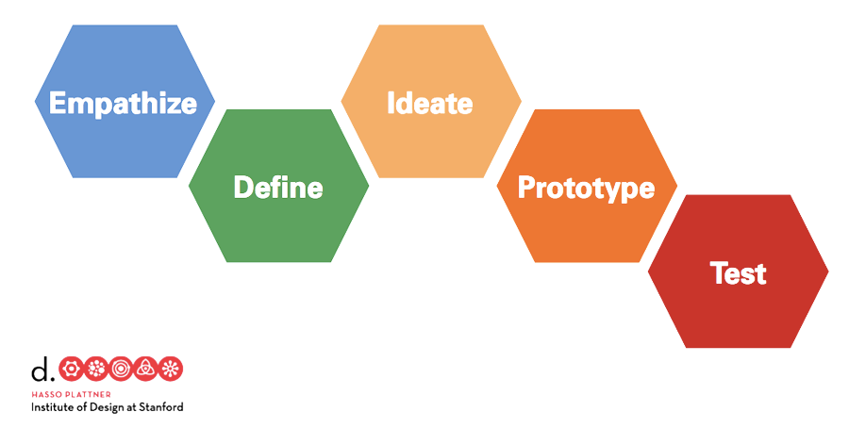
Design thinking
[additional content also: IDEO, LCC (2012). Design Thinking for Educators Toolkit.]
Notes:
DESIGN THINKING: a structured and collaborative approach used by designers to generate new ideas to find solutions to complex problems and challenges.

Slide 5
An example
“The rapid evolution of technology is changing not only the way students think and learn, but the paradigms for classroom instruction as well. For educational institutions, this increasingly means transitioning from traditional, instructor-guided class settings to more collaborative, interactive environments.
However, new models for active learning require more than modifying teaching methodologies. To engage and stimulate today’s students, the learning environment must also change…”
Source: Center for Innovative Teaching & Learning, Indiana University: “Node Chairs Move Students to New Activity.”
Here’s how Steelcase tackled this challenge
Notes:
SET UP VIDEO: see if you can see evidence of these

Slide 6
An example
Video example
Notes:
WHAT NOTICE? WHAT SEE?

Slide 7
WHO CARES?
"We choose to go to the moon in this decade and do the other things, not because they are easy, but because they are hard…”
–John F. Kennedy, 1962–

Slide 8
READY?

Slide 9
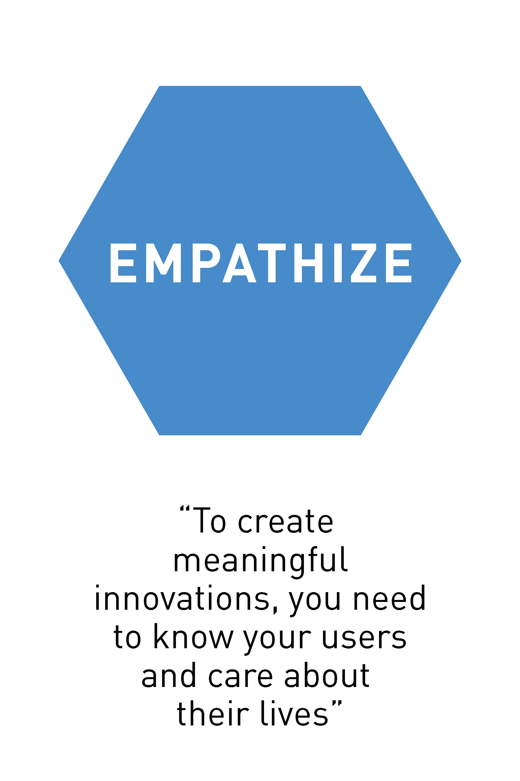
STAGE ONE
What’s the big idea?
Learn about the audience for whom you are designing
Understand people in the context of the challenge
Uncover what is “true” and “meaningful” for people…what do they believe?
What’s the what?
Seek out the voices/experiences of the “end” user
Observe, engage, watch, & listen to harvest rich stories
Notes:
Centerpiece of human-centered design
Not solving “our” problem
Learning to see with fresh eyes

Slide 10
STAGE ONE
We know there are a host of things people care about and that matter to the success of our work and efforts
Equity
Transportation
Credentialing
Recruitment
Sustainable Funding
And many, many more…
Notes:
SYNTHIZED STORIES --> THESE SENTIMENTS

Slide 11
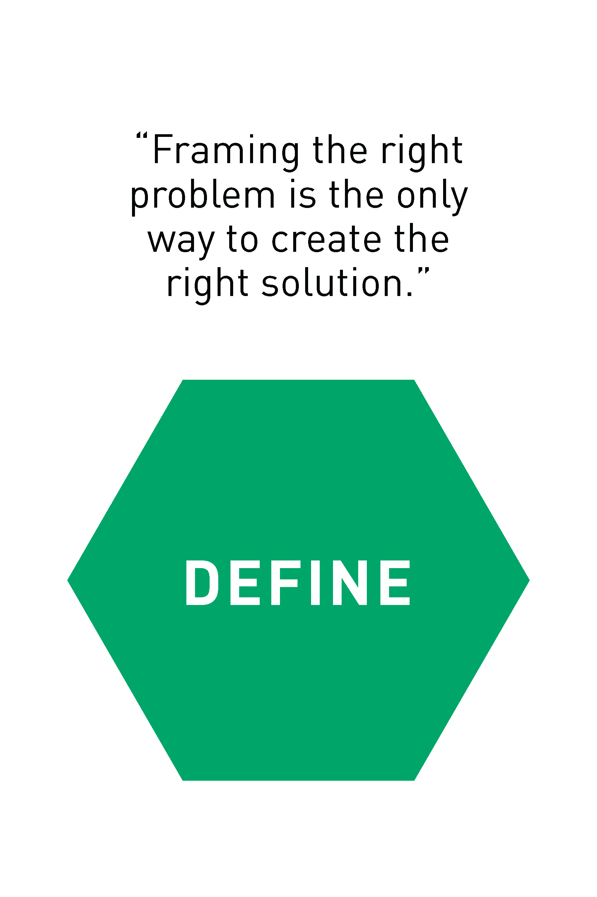
STAGE TWO
What’s the big idea?
‘Unpack’ & synthesize what you have learned from your empathy work to draw conclusions
Problem Finding vs. Problem Solving
Consider: What do I want to be “true”? What could be better? “How might we…?”
What’s the what?
Generate a problem statement based on patterns of observation
Construct a point of view that is based on “user” needs and insights [User + Need + Insight = POV]
Notes:
WHY IMPORTANT –
IT’S ABOUT DEFINING “THE RIGHT” PROBLEM”
Provides focus and frame problem
Inspires and empowers the team
Informs criteria for evaluating competing ideas
Captures hearts and minds

Slide 12
STAGE TWO
[[Insert defined ‘problems’ on this page]]
Notes:
FOR OUR PURPOSES, WE’LL USE A COLLECTIVE PROBLEM STATEMENT

Slide 13
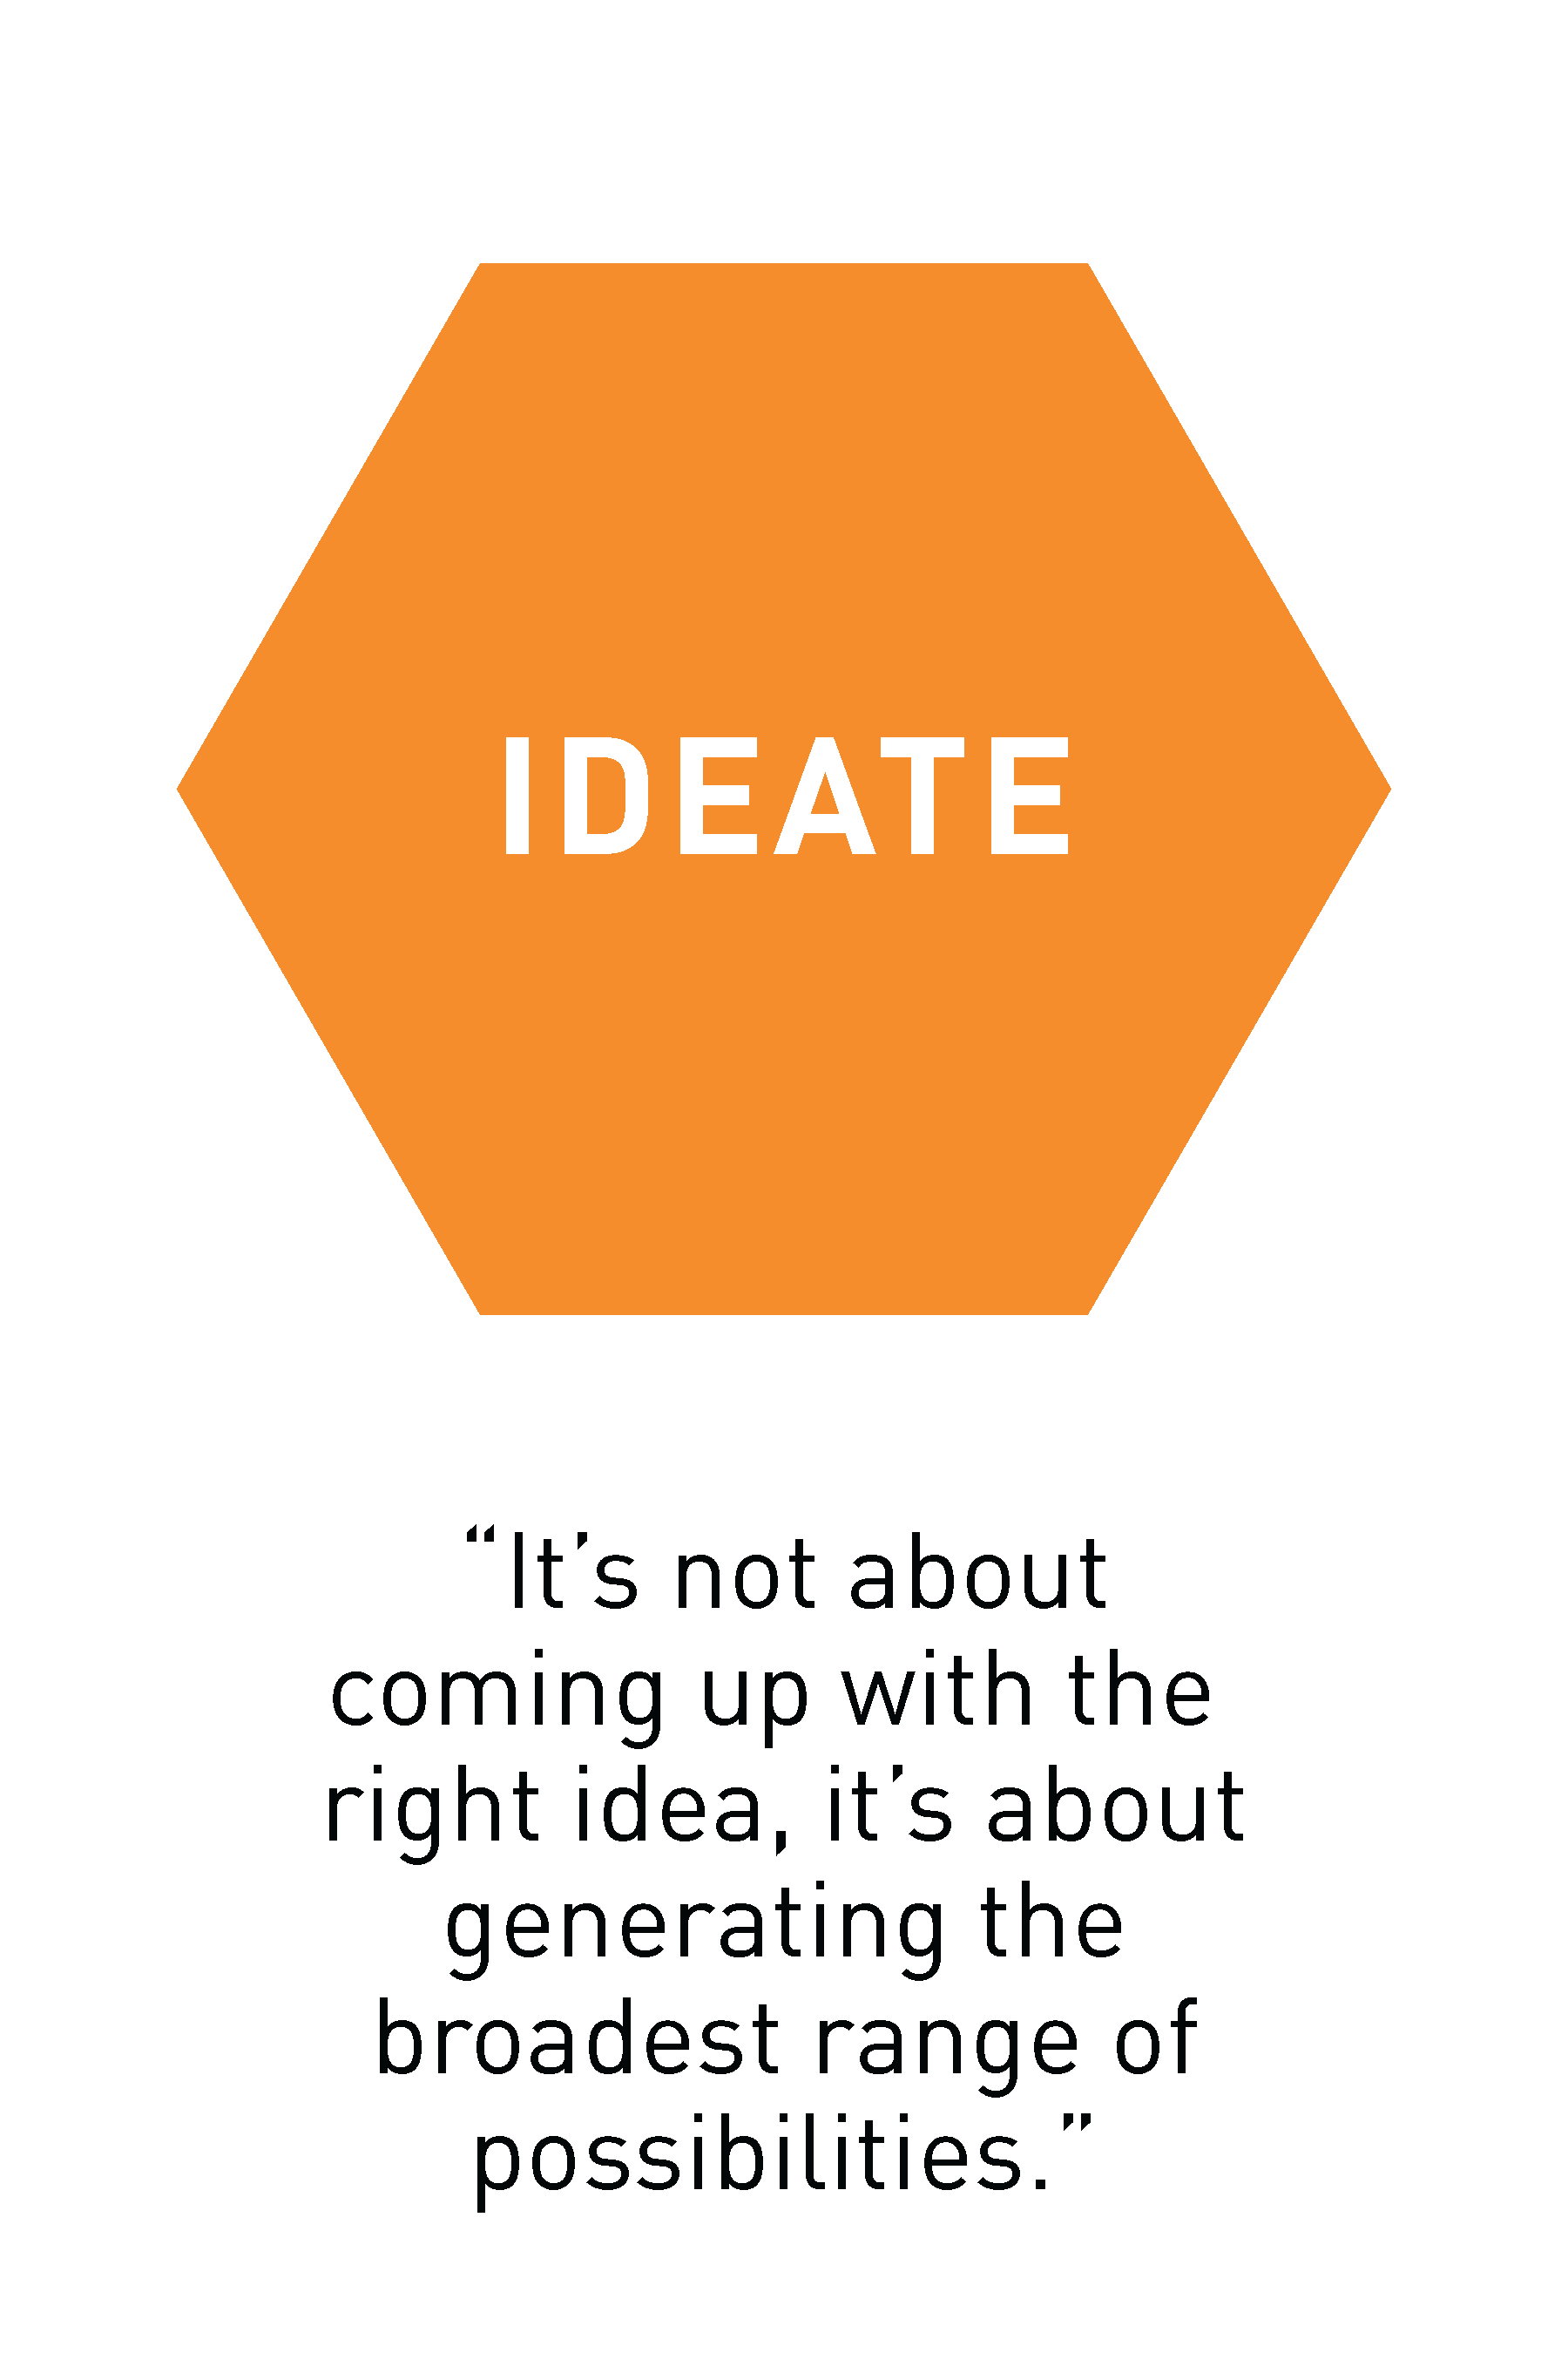
STAGE THREE
What’s the big idea?
Transition from identifying problems to creating solutions
Combine your understanding of the problem with your imagination
Pushing for the widest range of ideas (not finding a “best” solution”)
What’s the what?
Generate/brainstorm ideas
Go beyond the obvious to harvest the collective perspectives of the team & uncover the unexpected
Pursue volume and variety

Slide 14
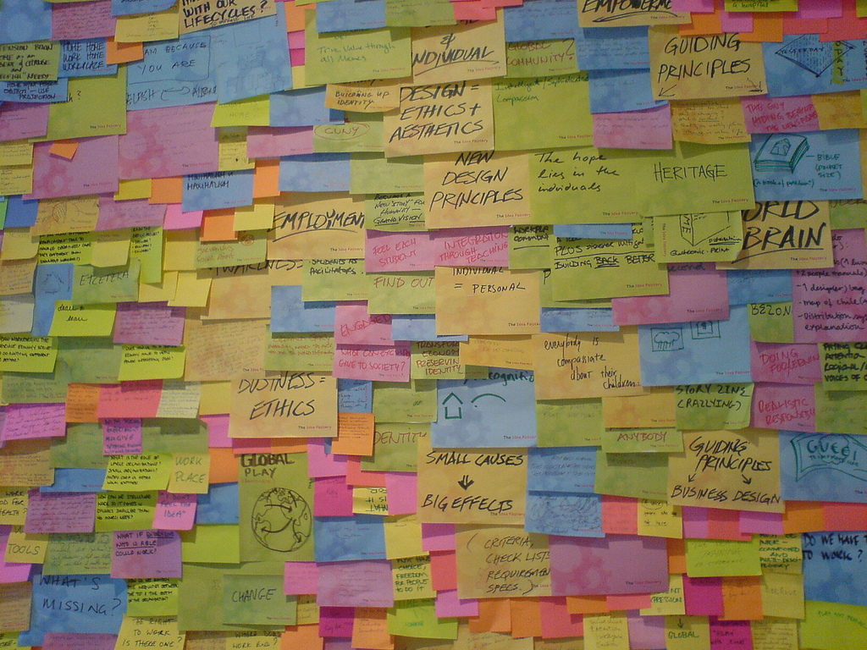
Notes:
This is what we are going for!!!!
Not one is “in charge” -- put up all the ideas you can.

Slide 15
STAGE THREE
DON’T…
Judge
Criticize or filter
Debate
Engage in “power concentration”
“Chat”
DO…
Defer judgement
Encourage wild ideas
Build on ideas of others
Stay focused on the problem
Be visual
Go for quantity
You can’t be wrong!
Make each other look brilliant!
Notes:
If stuck: add contraints (what if could only be solved with 10 million? 1000$); use inspiring brands (how would X do it?); focus on target audience

Slide 16
STAGE THREE
Refine your ideas
“Cluster” related ideas
Frame one or two “big” ideas
Do a reality check: What are the values/needs? The challenges/barriers?
Describe it in more detail:
What needs/opportunities does it address?
Give it a name
Sketch it
Identify/look for headlines >> one sentence statements

Slide 17
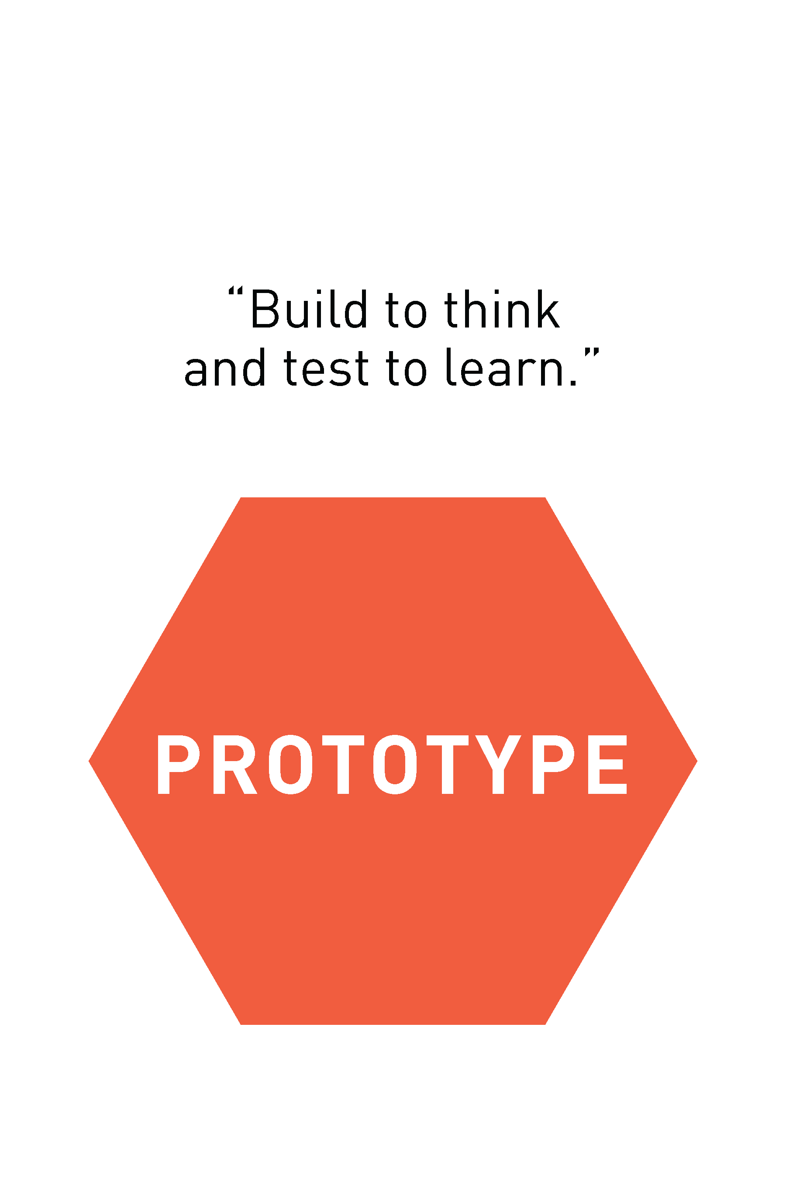
STAGE FOUR
What’s the big idea?
Prototyping is:
RAPID (don’t perseverate!)
An act of thinking/learning
A communication of ideas
The beginning of a conversation
Failing quickly to test possibilities
What’s the what?
Identify a key variable to work with & keep “user” in mind
Create a “scale” representation of one or two of your ideas (i.e., “flesh it out”): Mock-up, Model, Diagram, Storyboard, etc.
Notes:
“build to think and to learn”

Slide 18
STAGE FIVE
What’s the big idea?
Return to “user” group to test ideas
Refine prototypes and potential solutions (ITERATE!)
Learn more about the “user” (needs, insights, POV, etc.)
Refine your own POV of the challenge
What’s the what?
Show, don’t tell: let the ”user” use it, in context (create experiences)
If not possible, frame a situation where users take on the roles/task
Ask users to compare
“Always prototype as if you know you’re right, but test as if you know you’re wrong.”

Slide 19
IMPLICATIONS
Turn and talk
Questions
Questions
Notes:
WE’LL HARVEST BIG INSIGHTS FROM LARGE GROUP

Slide 20
CLOSING THOUGHTS
We are all designers
Stepping out of our
comfort zone = learning
Embrace a ‘beginner’s mind’
Problems are just opportunities
for design in disguise

Slide 21
Kyle hartung khartung@jff.org
TEL 617.728.4446 FAX 617.728.4857 info@jff.org
88 Broad Street, 8th Floor, Boston, MA 02110 (HQ)
122 C Street, NW, Suite 650, Washington, DC 20001
505 14th Street, Suite 900, Oakland, CA 94612
WWW.JFF.ORG

