Slide 1
Coaching call #1
Work-based learning
Anna O’Connor
December 17, 2018

Slide 2

Regional updates
Before we get started…
Any successes and/or milestones met since the summer?
Any new challenges and/or barriers emerge?
What’s the vision for 2018-19?
  Ensure that secondary partners are signed on and strengthen relationships so those partners are fully engaged and on-board
  Build out a new education pathway
  Strengthen the middle grade curriculum, outreach strategy, and orientation so students are better prepared for high school pathways, coursework, and expectations
  Develop a parent engagement strategy

Slide 3


What is work-based learning
Work-based learning is defined by activities and experiences when a student or worker:
Goes to a workplace or works with an employer
Does meaningful job tasks that (a) develop his or her skills, knowledge, and readiness for work and (b) support entry or advancement in a particular career field.
Work-based learning solves a problem faced by many Americans: it’s hard to get a job without work experience, and hard to get work experience without a job.

Slide 4
Core purposes of
work-based learning
Exposure to the world of work
Exposure to a career field
Strengthened academic learning
Development of professional skills
Temporary or permanent job
Workplace norms
Employers’ expectations
Understanding of a particular career or industry
Interaction with professionals in the field
Understanding of relevance of classroom learning
Application of classroom learning in real-world situations
Employability skills
Technical skills
Recognition of contributions
Developing social capital

Slide 5
JFF Work-based Learning Framework
Notes:
Continuua and experience to a itterative process
Getting a student from job shadow to internship, where system le
Sequence of events

Slide 6
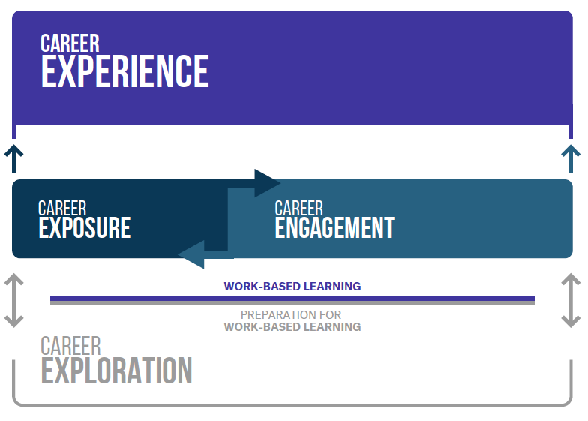
THREE KEY CHARACTERISTICS:
Foundation of career exploration and preparation for three phases of Work-Based Learning
Opportunity for reiteration (cycling back/no dead ends)
Meaning-making and reflection integrated throughout

Slide 7
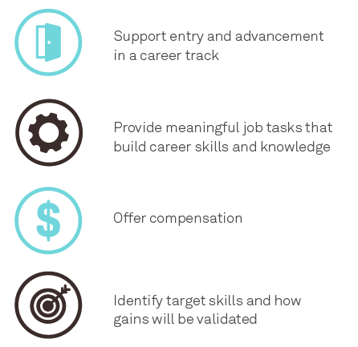
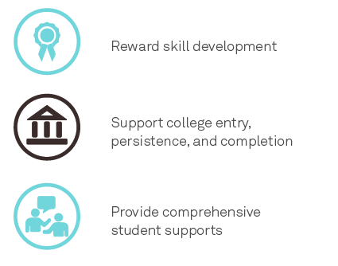
Making work-based learning work
Effective models of work-based learning should:

Slide 8
Notes:
What are you thinking?
How does all of this connect?
What should an academy graduate know and do as it relates to the industry?

Slide 9
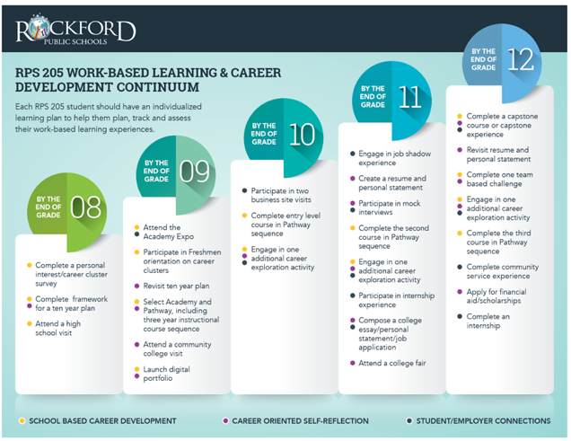
FROM STATE POLICY to Local IMPLEMENTATION:
Rockford Public Schools
Notes:
From the student perspctive from classroom to job-– who they

Slide 10
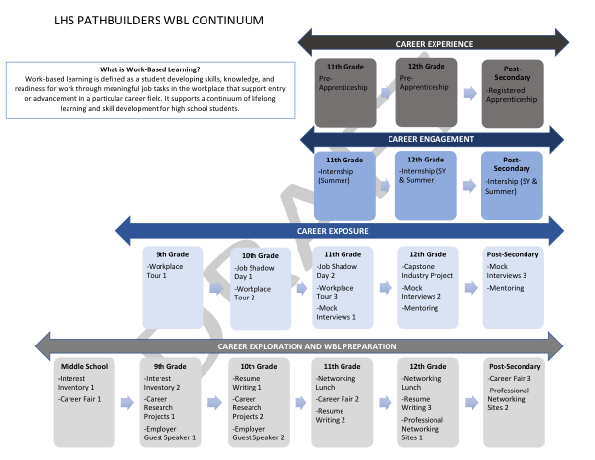

Slide 11
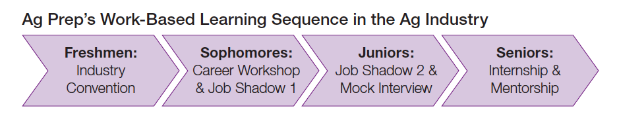
WONDERFUL COMPANY AGRICULTURAL PATHWAYS

Slide 12

Before we dive deep into each wbl phase…
Understanding the southwest wbl effort
Is WBL offered to all pathways students? Are there differences among high schools?
How similar or different are WBL opportunities for students in different pathways?
Who are the players in the WBL efforts for the region?
Now let’s start plotting activities across the phases…

Slide 13
The Foundation
Contributes to informed pathway and WBL decision-making processes
Equips students with knowledge and tools for success in WBL
Important for initiating and sustaining employer partnerships
Notes:
https://jff-prod.s3.amazonaws.com/documents/WBLSystemAssessment_092217.pdf
http://www.jff.org/initiatives/linked-learning-regional-hubs-excellence/work-based-learning-ideas-bank
GA Dept of Ed WBL manual

Slide 14
CAREER Exploration & preparation
What it looks like: Participants build a foundation for successful work-based learning by increasing their awareness of career options. Career Exploration activities do not take place in workplaces, but prepare participants to enter workplaces and make the most of work-based learning opportunities.
Models include: career fairs, industry projects, career speakers and mock interviews.
Employer-Facing Supports:
Recruit employees for career fairs, industry projects, and mock interviews
Provide employers sample mock interview questions and student resumes/profiles for preparation
Student-Facing Supports:
Create scavenger hunt for career fair
Guide students in researching careers
Facilitate interest inventory activities
Facilitate sequence of job readiness workshops
Notes:
Career exploration activities that increase participants’ awareness of career options can build a strong foundation for successful work-based learning. While activities such as career fairs, industry projects, and mock interviews do not take place in workplaces and are not forms of work-based learning, these activities prepare participants to enter workplaces and make the most of work-based learning opportunities.

Slide 15
CAREER exposure
What it looks like: Participants enter workplaces for short periods of time with the goal of gaining introductory information about an industry and associated occupations.
Models include: job shadowing, company/workplace tours, informational interviews, and mentoring.
Employer-Facing Supports:
  Guidance on Job Shadow Day schedule
  Informational Interview feedback template
  Mentor training
  Chaperones for workplace tours
Student-Facing Supports:
  Student matching
  Permission slips and confidentiality agreements
  Question creation and review for interviews
  Check-ins to support mentoring relationship
Notes:
Career exploration activities that increase participants’ awareness of career options can build a strong foundation for successful work-based learning. While activities such as career fairs, industry projects, and mock interviews do not take place in workplaces and are not forms of work-based learning, these activities prepare participants to enter workplaces and make the most of work-based learning opportunities.

Slide 16
CAREER engagement
What it looks like: Participants increase their knowledge of an identified field of interest while gaining employability skills and some entry-level technical knowledge or skills.
Models include: internships, co-ops, and simulations.
Employer-Facing Supports:
Student recruitment/marketing of opportunity
Co-creating interview protocol and coordinating interviews
Co-creating job descriptions
Advise on Supervisor/Manager trainings
Advise or participate in Student-Manager 1:1
Unpacking labor laws and other liability concerns
Student-Facing Supports:
Online applications
Coordinating student interviews
On-boarding documentation
Wrap-around support through duration of opportunity
Financial planning workshops

Slide 17
CAREER experience
What it looks like: Participants gain specific skills and paid work experience in a particular industry and/or occupation.
Models include: apprenticeship, on-the-job training and transitional jobs.
Employer-Facing Supports:
  Co-create an occupational training outline
  Align on-the-job training with academic curriculum
  Manager training and support
  Advise on critical components of training
  Convene education/employer meetings
Student-Facing Supports:
  Connect, identify, and recruit students
  On-boarding documentation support
  Retention activities
  Provide wrap-around services

Slide 18

Understanding your role
How are you currently involved in developing and supporting WBL?
What are some strengths and challenges you’ve observed so far?
How could your involvement change to enhance delivery of WBL?

